Slide 1

Team 7

Slide 2





SaniLamp
Automated UVC-light car sanitizer for family vehicles and shared-vehicles
Efficiently kills pathogens to prevent the spread of infectious diseases
Current cleaning methods are subject to shortages (cleaning supplies) or require manual labor (UV wands)
Hands-free way to sanitize car surfaces, prevent spread of disease, and reduce waste
Victoria Lara
CEO
vlara@bu.edu
David Rak
VP of Finance
drak77@bu.edu
Radhey Patel
VP of Engineering
rexu6@bu.edu
Isabelle Goode
VP of Marketing
igoode@bu.edu
Notes:
Victoria

Slide 3
Company Overview
SaniLamp provides owners of passenger vehicles with a automated, affordable UV-C light sanitizing device to clean their car at frequent intervals and prevent the spread of communicable diseases like COVID-19.
Notes:
Isabelle

Slide 4
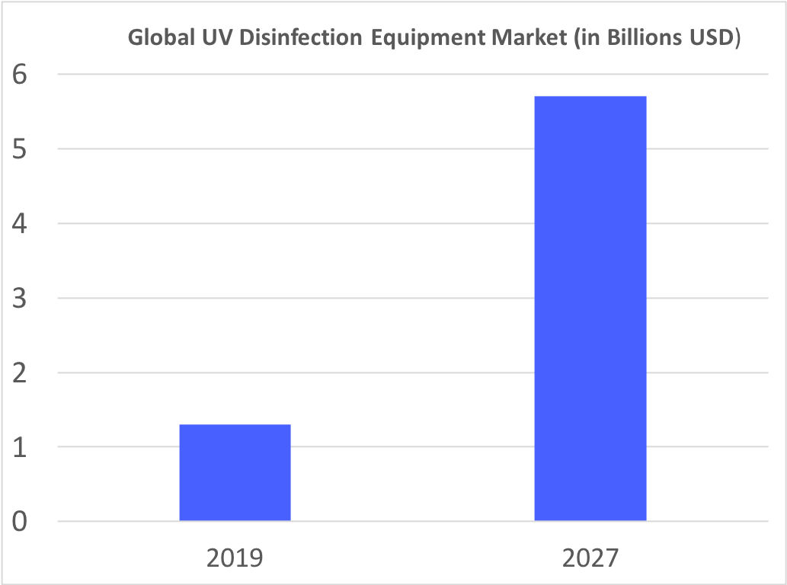
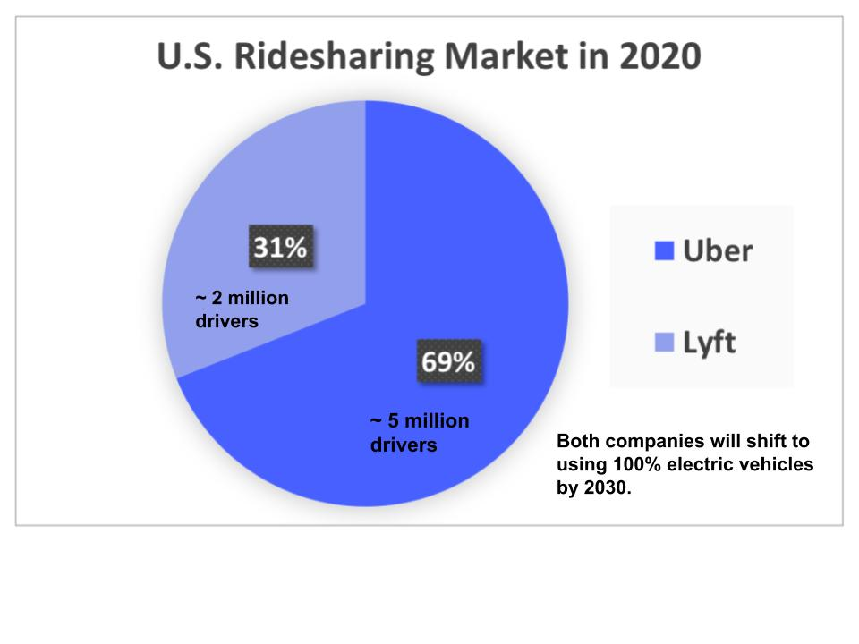
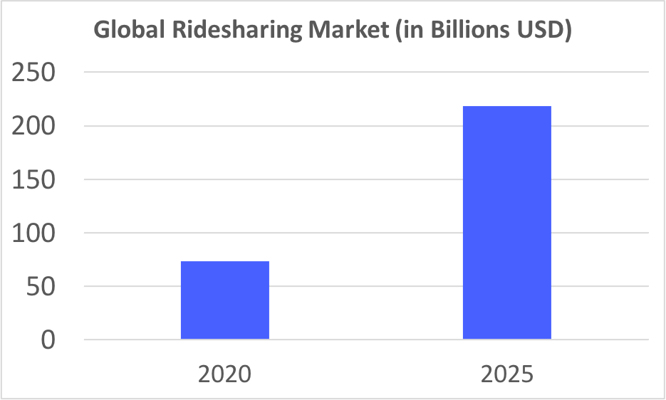
Problem Statement and Market Opportunity
Rideshare bookings down 75%
Traditional cleaning products produce waste and are in short supply
Other UV-C sanitizers are expensive or require hands-on use
Notes:
Isabelle

Slide 5
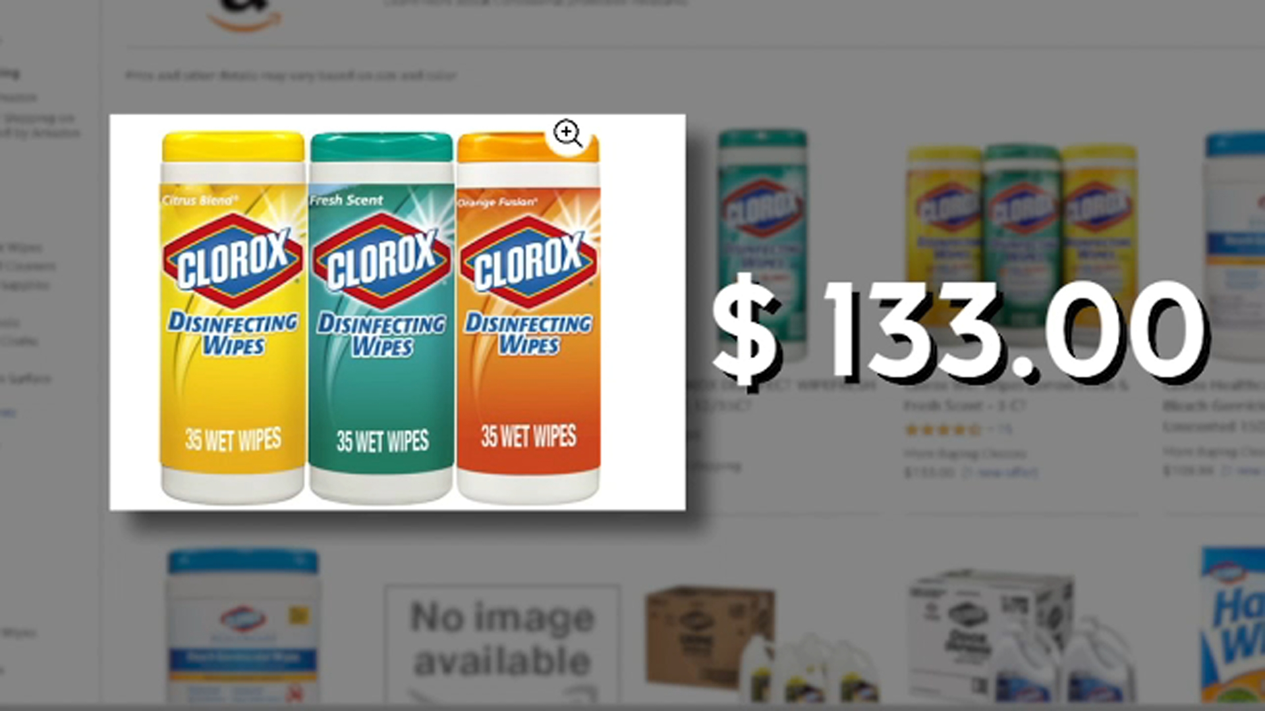
Solution Statement
4,304%
$50-66
Notes:
Radhey Detail your product/service and the benefits/value it brings to customers (this may require two slides but if at all possible limit it to one).
How does this product address the pain point in your target market?
What is the economic impact? $45/ 1 box
What is the compelling reason to buy?

Slide 6
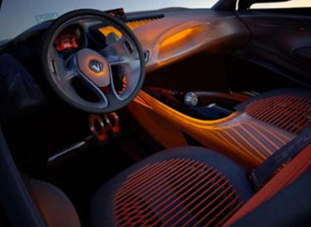
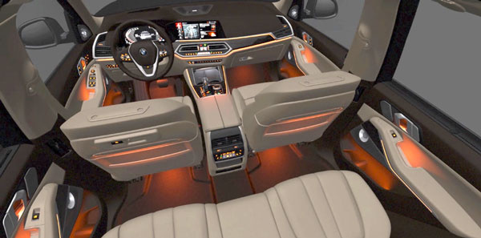
Solution Statement
Notes:
Radhey
If you have a technology business you may need to add a slide to show the product architecture to show that you have worked out how you are going to do this. But, don’t go overboard with technical detail and language.

Slide 7
Your Secret Sauce
Unique: adaptable, cost-effective, novel cleaning tech
Leading edge: partnerships
“Unfair advantages”: None
Barriers: existing competitors and stony buyers
Notes:
Victoria
What makes your company unique?
Do you have any edges in technology, or process, or people, or relationships? What are they? Describe them.
Do you have any “unfair advantages”? Patents? Other?
Barriers to entry

Slide 8
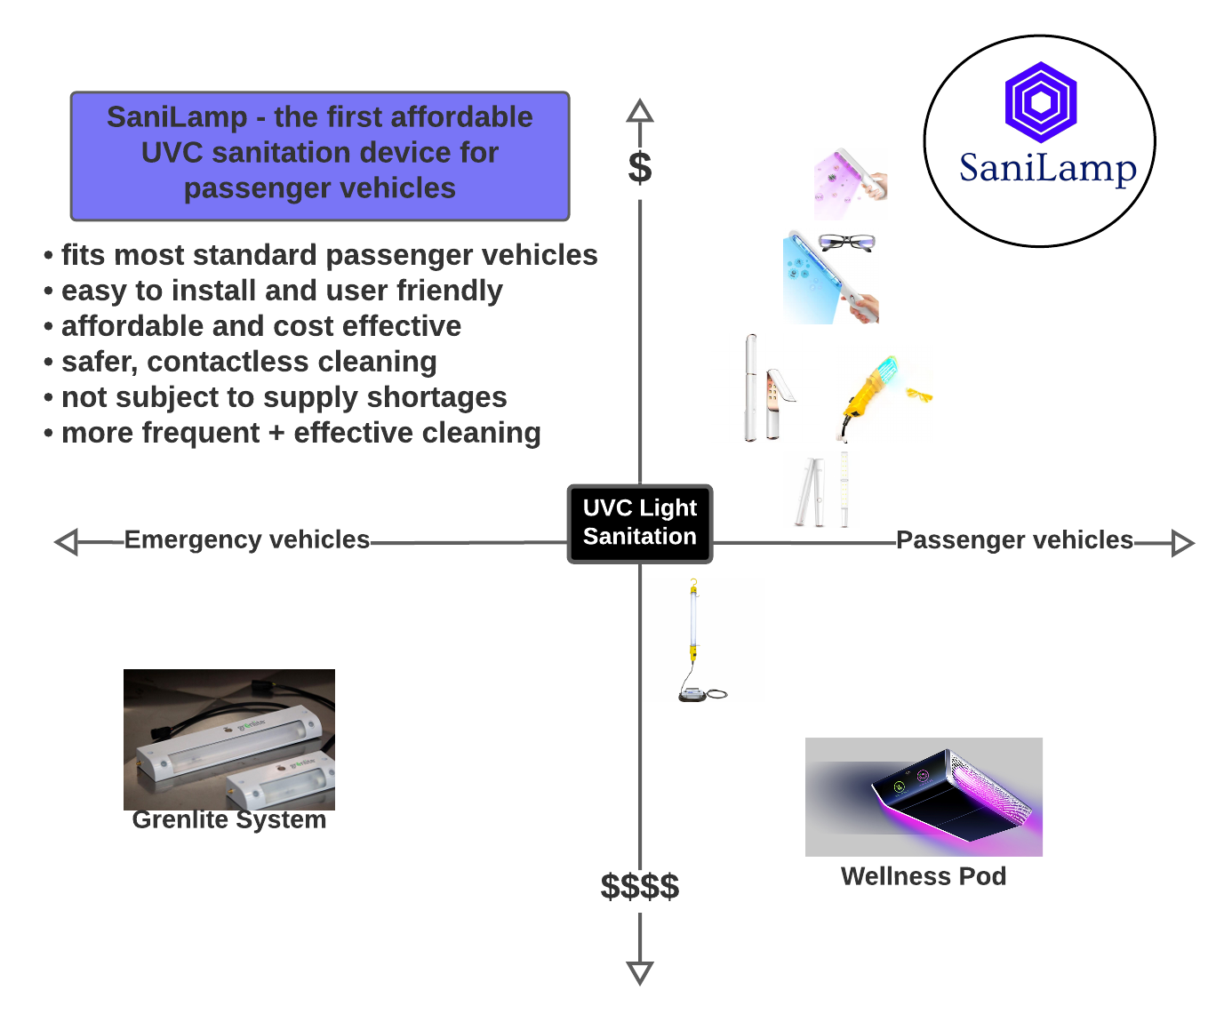
Competition
Notes:
Isabelle

Slide 9


Sales & Marketing
Sales
Brick-and-mortar and online stores
Channels will sell, company website will have a lower price ($65 vs $50)
Marketing plan
Channels: Amazon, Target, Company Website
Use channels to market product
Mainly web advertising, some radio
Notes:
Victoria
How will you sell the products?
What is your go-to-market strategy?
Who will sell, and how?
What is your overall marketing plan?
Channels of distribution?

Slide 10





Partnerships and Other Collaborations
RideShare Partner
Bus Partner
Notes:
Radhey * How will you establish those partnerships

Slide 11


Partnerships and Other Collaborations
Research Partner
Manufacturing Partner
Notes:
Radhey * How will you establish those partnerships
Who will you need as partners in order to succeed?
Production? Distribution? Funding? Other?

Slide 12
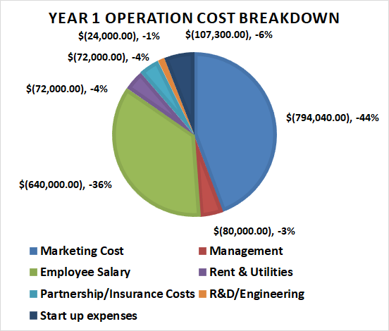
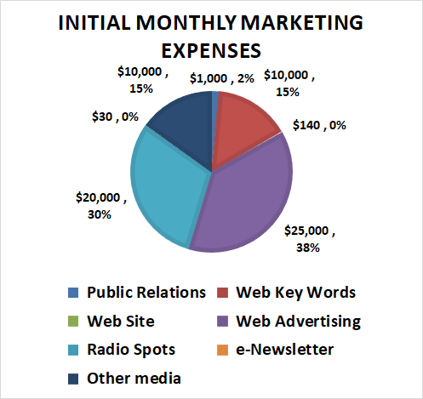
Milestones and Marketing
What progress have you made to date?
Describe the milestones in the development of your venture, and show which ones you have achieved. How will you win in the market? Use a chart or timeline. Not too many words!
How will you sell the products?
What is your go-to-market strategy?
What is your marketing plan
Notes:
Rak

Slide 13
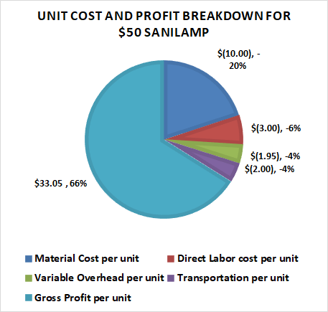
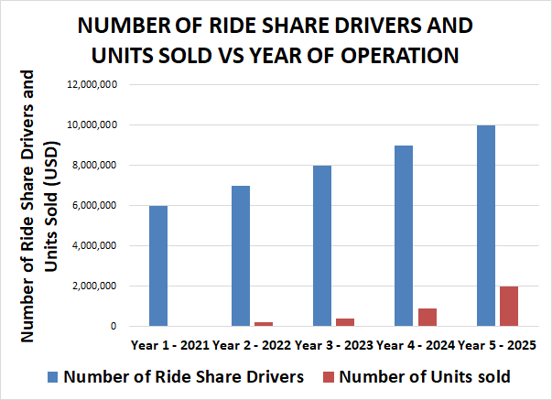
Cost Breakdown and Units Sold Projections
Notes:
Rak

Slide 14
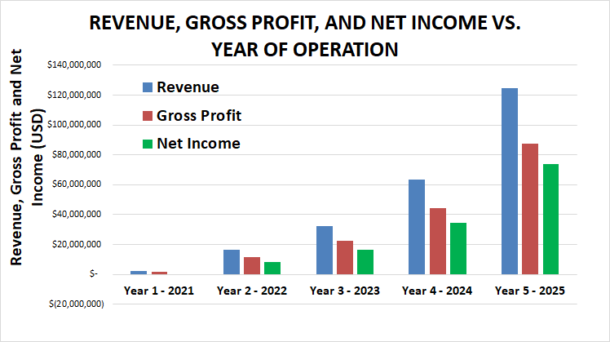
How Will You Make Money
High level financials (5 years desirable)
Revenue projection, by major revenue category, by year
Cost projection, by major cost category, by year.
Breakeven point (where you first start making money)
Show projected employee headcount
Describe pricing and revenue model (what you will charge, how you will charge it, etc.)
Have backup, more detailed, financial information with you in case you need to answer questions
Notes:
David

Slide 15
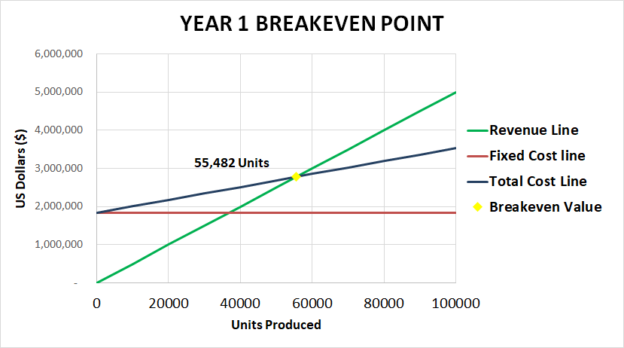
Break Even Analysis
High level financials (5 years desirable)
Revenue projection, by major revenue category, by year
Cost projection, by major cost category, by year.
Breakeven point (where you first start making money)
Show projected employee headcount
Describe pricing and revenue model (what you will charge, how you will charge it, etc.)
Have backup, more detailed, financial information with you in case you need to answer questions
Notes:
David

Slide 16
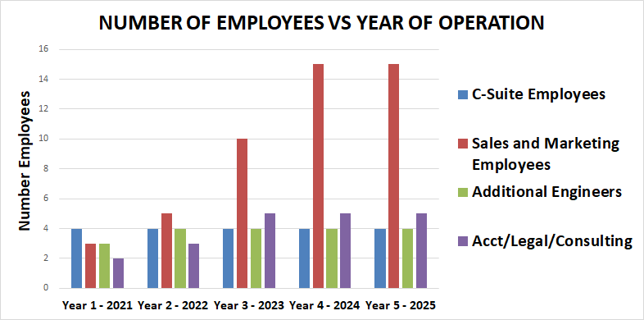
Employee Headcount & Management
Notes:
Rak

Slide 17
CTO/VP of Engineering Radhey Patel
Hardware Designer 1
Hardware Designer 2
QA & Testing
CFO/VP of Finance David Rak
CEO Victoria Lara
Internal Accountant
CMO/VP of Marketing Isabelle Goode
Marketing Assistant
Sales-Marketing Intern
Sales Associate
HR Admin
Notes:
Radhey - Look at my employee headcount and change it if you want
Who are the key team members?
What are their backgrounds? Keep it high level on the slide -- you can provide detail verbally. Focus on the experience and expertise that is relevant to your business.
Why will this team win?
What key hires will you need to make, and when?
Note: If your management team isn’t at critical mass (which is probably the case), augment this slide with your list of advisors. Even with a robust management team if you have a stellar list of advisors you should show them on this slide.

Slide 18
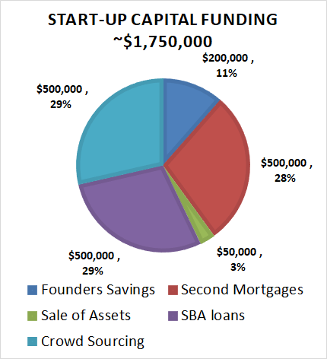
Use of Funds and Exit Strategy
Start-up funds
Bootstrap it
Government Loan
Crowdsourcing
Exit Scenarios
Bought out by partner
Acquired by other car products company
How much money do you need?
What are you going to use the money for?
What are your projections for future fundraising needs?
What are the possible exit scenarios
If acquisition is a likely exit then identify who might be a potential acquiring company
If there are any comparable exits in your market space, identify them
Notes:
David

Slide 19
Summary
Ensuring people’s safety and helping businesses secure client-base
Cost-effective, adaptable, and easy to use!
Pathogen resistance on the rise = need for novel cleaning techniques
Notes:
Victoria
Why what you are doing matters! Why are you different! Why you will win! Why someone should invest!

